Slide 1
Process Concept Module 3
Operating Systems

Slide 2
Chapter Outline
Process Concept
Program vs Process
Process Control Block
Process Table
Context Switch
Process states
Process states transitions
Process life cycle
Five state process model
Unix process state transition diagram

Slide 3
Process Concept
A process is basically a program in execution
or that which a processor executes
A process is unit of work in a system
A process is an activity performed by a system
It may be program’s data, program counter, pointer or register used in a program
A process uses resources like CPU, memory, files and I/O devices
Operating system processes execute system code and user processes executes user code

Slide 4
Program vs Process
A program is a passive entity
A process is a dynamic entity represented by the values stored in registers, memory, program counters etc.
A program does not compete for the computing resources whereas a process does
One program can have several processes
Consider multiple users executing the same program

Slide 5
Process Concept
Multiple parts
The program code, also called text section
Current activity including program counter, processor registers
Stack containing temporary data
Function parameters, return addresses, local variables
Data section containing global variables
Heap containing memory dynamically allocated during run time

Slide 6
Process Concept
Process idea was first used in Multics
All programming OS, such as Windows NT, or MVS (multiple virtual storage) were built around the concept of process
Major requirements that the OS must meet can all be expressed with reference to process
OS must interleave the execution of a number of processes to maximize processor use
OS must allocate resources to process in confirming to a specify policy
e.g. certain functions or applications are of higher priority
at the same time avoiding deadlock
OS may support inter-process communication

Slide 7
Process Control Block (PCB)
When a new user program is initiated
OS creates a data structure, called Process Control Block (PCB), which gives substance to the process and serves to control it
Each process is represented by its own process control block
PCB is a data block or record containing information associated with a specified process
Allows the OS to locate all key information about a process
When the OS switches the attention of the CPU among various active processes
It uses the same area in PCB to hold the information
That information used to restart process when the process next gets CPU
Process control block is also called task control block

Slide 8
Process Control Block (PCB)
PCB contains following information about process
Current state of the process
Unique identification of process
A pointer to process parent
Pointer to process’s child processes
The process’s priority
Pointer to locate the process memory
Pointer to allocate resources
The register save area – CPU register
The processor it is running on
Accounting information
I/O state information

Slide 9
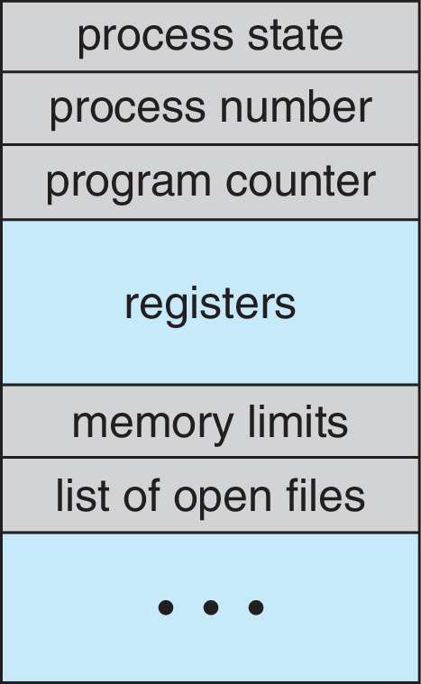
Process Control Block (PCB)

Slide 10
Process Table
OS maintains the process table with one entry per process
This entry contains information about process’s
state
its program counter
stack pointer
memory allocation
the status of its open file
its accounting and scheduling information
its priority

Slide 11
The Shell
It is a command interpreter
It is a process which starts by typing a command at prompt
It provides an interface to the OS for the user
A facility for online users rather than batch
Command can be entered
directly at an online terminal
through shell program or script
a text file having series of commands forms a script
DOS shell is alternative as screen oriented interface

Slide 12
The Shell
In Unix when any user login in, a shell is started up
It starts up as soon as user types some thing at command prompt, e.g. date
The shell creates a child process and run the date program
When child is running shell waits for its termination
When child finishes, the shell types $ prompt again and wait for next command

Slide 13
Operations on Process
A system managing processes may perform following operations
Create a process
Destroy a process
Suspend a process
Resume a process
Block a process
Wakeup a process
Dispatch a process
Change process’s priority
Enable a process to communicate with other processes
For long term suspension, process’s resources should be free
Changing the priority of process normally involved modifying the priority value in PCB

Slide 14
Process Creation & Termination
A process may create other processes
When a process creates a new process
The creator process is called the parent process
Created process is called the child process
Act of creating a process is called spawning a process
A child process may share the resources of its parent process

Slide 15
Process Creation & Termination
A parent may wait for its child process to terminate before resuming or may run concurrently with the child process
A child process may run the same program as that of its parent or may run a separate program
In DOS, parent and child process do not run in parallel and parent process will suspend itself till child has finished

Slide 16
Process Creation & Termination
When a process is created the following operations are performed
Process naming (process id)
Creates the process control block
Insert it in process table
Determine the process initial priority
Allocate the process’s initial resources
Allocate the address space to be used by the process
When a process is destroyed following operations are performed
Its resources are returned to the system
Its process control block is erased
It is purged from any system list or table

Slide 17
Reasons for Process Creation
New batch job
In a batch environment, a process is created in response to the submission of a job
Interactive log on
A user at a terminal logs on to the system
Created by OS to provide a service
OS can create a process to perform a function on behalf of a user program, without user having to wait, e.g. printing
Created by existing process
A user program can create a number of processes
Typically related processes need to communicate and cooperate each other
Achieving this cooperation is a difficult task for the programmer of OS

Slide 18
Reasons for Process Termination
There must be some means for a process to indicate its completion
A batch job should include a halt instruction, which generates an interrupts to alert the OS that a process has completed
For an interactive application, the action of the user will indicate whether the process is completed

Slide 19
Reasons for Process Termination
Following are the possible reasons for process termination;
Normal termination
The process executes an OS service call to indicate that it has completed running
Time limit exceeds
The process has run longer than the specified total time limit which includes
total time elapsed
amount of time spent executing
in case of interactive process, he amount of time since the user last provided any input
Memory unavailable
The process requires more memory than the system can provide

Slide 20
Reasons for Process Termination
Bounds violation
The process tries to access the memory locations that is not allowed to access
Protection error
The process attempt to use a file that is not allowed to use or,
It tries to use it in improper fashion, such as writing to a read only file
Arithmetic error
The process tries a prohibited computation such as division by zero
Time overrun
The process has waited longer than specified maximum for a certain events to occur

Slide 21
Reasons for Process Termination
I/O failure
An error occur in input or output, such as
inability to find a file
failure to read a write after a specified maximum no of tries (when, e.g. a defective area is encountered on a diskette) or
invalid operation (such as reading from the line printer)
Invalid instruction
The process attempts to execute a non-existent instruction (often a result of branching into a data area and attempting to execute data)
Privileged instruction
The process attempts to use an instruction reserved for the operating system

Slide 22
Reasons for Process Termination
Data misuse
A piece of data is of the wrong type or is not initialized
OS or operator intervention
For some reason, the operator or the OS has terminated the process (e.g. if a deadlock exists)
Parent termination
When a parent terminates, the OS should be design to automatically terminate all the offspring of that parent
Parent request
A parent process typically has the authority to terminate any of its offspring

Slide 23
Process States
A process may have the following three states
Running
Instructions are being executed
Waiting/Blocked
The process is waiting for some event to occur (may be I/O completion)
Ready
The process is waiting to be assigned to processor
At any instant a process is in one and only one of three states
Process entering the system must go initially into the ready state
Process can only enter the running state via the ready state
Many OS are constructed using only these three states
However, there is good justification for adding additional states to the model

Slide 24
Process States
New
Process arrival
I/O Completion
Ready
Blocked
Scheduling
Interrupt /
Time expired
I/O request
Running
Terminated
Process terminates

Slide 25
Process State Transitions
Transition-1:
Occurs when a process cannot continue may be due to I/O request
Transition-2:
Request when scheduler decides that the running process has run long enough , and it’s the time to give CPU to other processes in ready state
Transition-3:
Occurs when all the other process have had their CPU time and its time for the first process to run again
Transition-4:
Occurs when external event for which process was waiting happens. If no other process is running at that time, transition-3 will be triggered and the process will start execution

Slide 26
Process State Transitions
Ready
4
Blocked
3
2
1
Running
The four transitions can be indicated as follows
Block running → block
Timerunout running → ready
Dispatch ready → running
Wakeup block → ready

Slide 27
Process Scheduling
Process scheduler selects among available processes for next execution on CPU core
Goal: Maximize CPU use, quickly switch processes onto CPU core
Maintains scheduling queues of processes
Ready queue
set of all processes residing in main memory, ready and waiting to execute
Wait queues
set of processes waiting for an event (i.e., I/O)
Processes migrate among the various queues

Slide 28
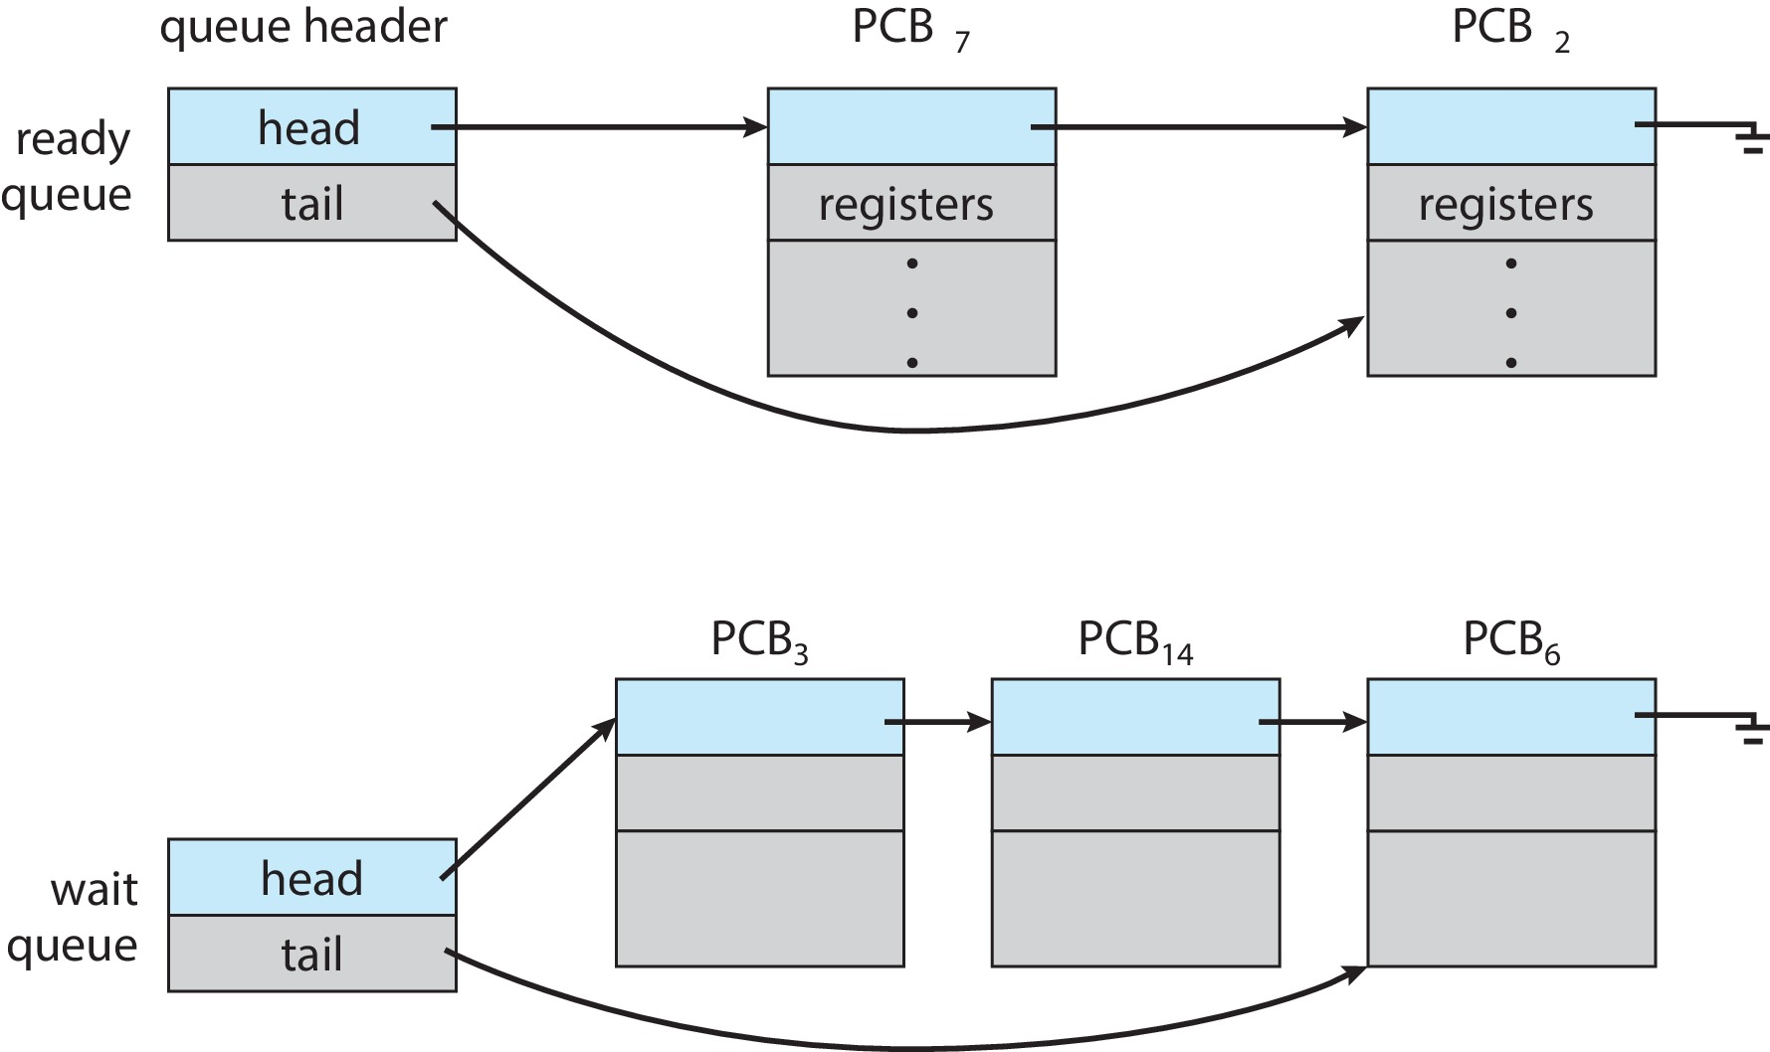
Process Scheduling: Ready and Wait Queues

Slide 29
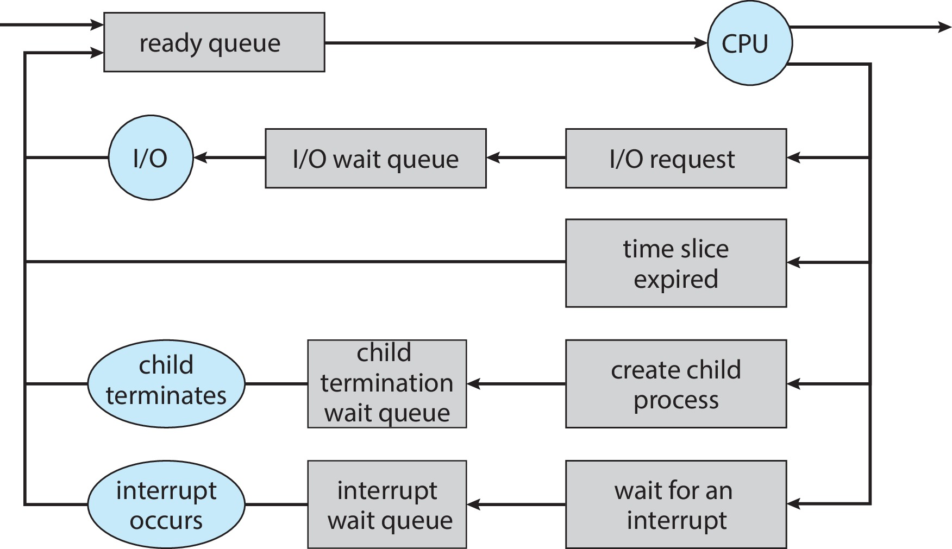
Process Scheduling Representation

Slide 30
Context Switch
Context switching is the procedure of switching of process from processor to memory and vice versa in a multiprogramming environment
When CPU switches to another process
The system must save the state of the old process
Load the saved state of the new process
Context switch involves storing and loading the values of each of the process’s control block, and process registers, such as;
The program counter (Holds the address of the next instruction to be executed. After an instruction executes, the PC updates to the next one.)
Index register (Holds the current instruction being decoded and executed.)
General register (Used to store data temporarily (numbers, results, or intermediate values) during calculations)
Stack pointer etc (Holds an index value used for addressing memory locations)

Slide 31
Context Switch
Context switch is pure overhead
The system does no useful work while switching
Context switch time depends on hardware support e.g, memory speed, the number of registers etc.
Its range is from 1 to 100 microsecond
This speed vary from system to system

Slide 32

Context Switch

Slide 33
Process Life Cycle
As a process executes, it changes state
new: The process is being created
running: Instructions are being executed
waiting: The process is waiting for some event to occur
ready: The process is waiting to be assigned to a process
terminated: The process has finished execution

Slide 34

Process Life Cycle

Slide 35
Process Life Cycle
Assume that process is running with a Unix operating system with no user process
Various events in life of processes within a multiprogramming system are given below;
User using the shell command interpreter, types in a program name, say solvit
The shell finds this program and program code will be loaded
A system call will be used to generate a process corresponding to the execution of the solvit program
The OS creates process control block in the memory
The process solvit will now begin to run – the process is said to be in running state
After a while, solvit needs to read some data from a disk file and issue an appropriate system call
The process is now said to be in the blocked state

Slide 36
Process Life Cycle
In the meantime, another user wants to run a program called myprog
A new process is created for myprog and since solvit is currently idle, execution begins; myprog is now running
The I/O delay which is blocking solvit now ends and solvit wants to restart; solvit is now said to be in ready state
The OS scheduler now decides that myprog has enough processor time (Timeout) and moves it into the ready queue
Solvit is restarted and enters the running state once more
Switching between active processes, waiting for I/O transfer etc. will continue for the life of the processes
Eventually, solvit completes its tasks and terminates; it leaves the running state and disappears from the system
Similarly, myprog terminates

Slide 37
Five State Process Model
Admit
Ready
Dispatch
Running
Release
Time-out
I/O Completion
I/O Request
Blocked
Resume
Suspended
Resume
Suspended
Suspended
Ready
Suspended
Admit
Blocked
Suspended

Slide 38
Five State Process Model
There are two queues; a ready queue and a blocked queue
OS chooses a process the ready queue to run
In the absence of any priority scheme, this can be a simple FIFO
A running process is removed from execution, it is either
Terminated
Time quantum is over
Performed I/O
After I/O completion processes in blocked queue are moved to ready queue
When an event occurs, the OS must scan the entire blocked queue
In a large OS, there could be hundreds or even thousands of processes in that queue
It would be more efficient to have a number of queues, one for each event
When an event occurs, the entire list of processes in the appropriate queue can be moved to the ready state

Slide 39
Five State Process Model
Consider a system that does not employ virtual memory
Each process to be executed must be loaded fully into memory
In multiple blocked queuing model, all the processes in all the queues must be resident in memory
Memory holds multiple processes
Solutions
Expand the memory
it has own flaw
Cost associated with expansion
Swapping
Moving part or all of a process (blocked) from memory to disk (suspended queue)
The space that is freed up in memory can be then be used to bring another process
When a process is suspended, it becomes dormant and merely waits until it is resumed by the system or user

Slide 40
Five State Process Model
A process can be suspended for the following reasons;
Process being swapped put of the memory by the memory management system in order to free memory for higher priority processes
A user may wish to suspend execution of a program for purpose of debugging a program
Process investigates previous effects of the process
Processes designed to run periodically to monitor system usage
The OS may suspend a background or utility process or a process that is suspected of causing a problem
The process can be suspended while in running, ready or blocked state

Slide 41
Unix Process State Transition
Kernel running
User running
Zombie
Exit
Return
9
2
1
System call interrupt
Sleep
Sleep in memory
Preempt
Ready to run in memory
Return to user
4
3
7
Preempted
wakeup
Swap out
Enough memory
Swap out
Swap in
6
5
8
Fork
wakeup
Not enough memory
Sleep swapped
Ready to run swapped
Created

Slide 42
Unix Process State Transition
Nine process states are recognized by the Unix System V operating system
Unix employ two running states to indicate weather the process is executing in user mode or kernel mode
Unix process states are;
User running
Executing in user mode
Kernel running
Executing in kernel mode
Ready to run (in memory)
Ready to run as soon as kernel schedules it
Sleeping in memory
Unable to run until an event occurs
Ready to run (swapped)
The swapper must swap the process into memory before the kernel can schedules it to execute

Slide 43
Unix Process State Transition
Sleeping (swapped)
The process is waiting for an event, swapped to a disk
Preempted
Process is returning from kernel to user mode, but the kernel preempts it and does a context switch to schedule another process
Created
Process is newly created and not yet ready to run
Zombie
Process no longer exist, but it leaves a record for its parent process
A distinction is made between two states; ready to run, in memory and preempted
These are essentially the same states as indicated by the dotted line
Preemption can occur when a process is about to move from kernel mode to user mode

